Slide 1


Induction Training
Issue No: 02
Issue Date: 15/02/2024
Sino Iron Project Site Induction

Slide 2
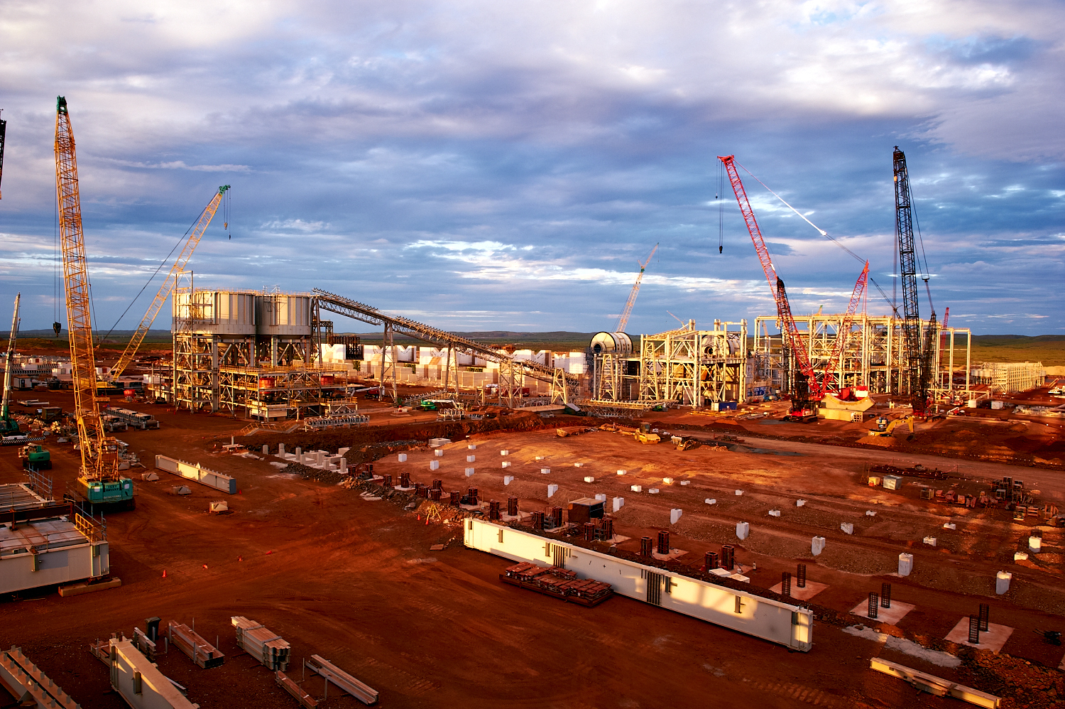
Induction Objectives
Welcome to the Sino Iron Project. At the end of this Induction you should be able to understand the following:
About YAT Engineering and Construction
YAT Employees Duty of Care
Mine Environment
Citic Pacific's Site Policies and Procedures
Mine Safety Rules
Emergency Procedures

Slide 3

About YAT Engineering and Construction
YAT Engineering and Construction (YAT) is an industrial engineering design and construction company located in Western Australia. YAT Engineering and Construction was formed in 2012 in Perth, Western Australia and has now expanded into the North West region of WA.
In 2012, YAT established an engineering design and drafting service division focussed on servicing Clients in the residential, commercial and mining sectors. Drawing from existing capabilities and previous experience a construction division was created in 2015. The engineering and construction divisions work together to specialise in structural, civil design and construction projects. A maintenance division also operates alongside the construction component of the company expertly delivering maintenance solutions to operational mine sites.

Slide 4
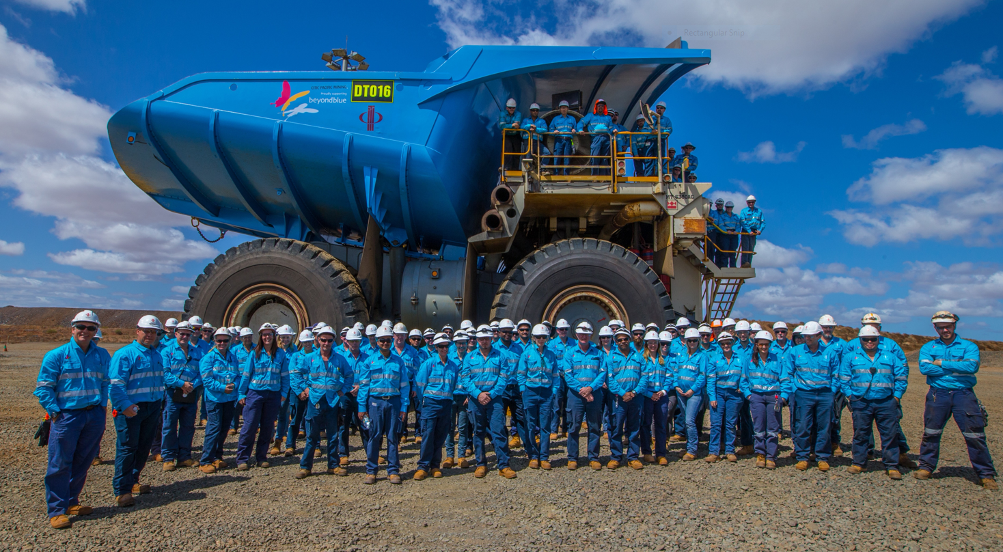
YAT Mission Statement
To deliver exceptional design, construction and maintenance outcomes for our Clients through highly effective teamwork, communication and attention to detail. To exceed out Clients expectations.
‘To Design, Create and Surpass’
OUR VALUES
Teamwork
We work together towards our common goals
We take responsibility and are accountable to our own roles
We communicate with respect and honesty
Commitment
We are committed to our people
We are committed to continuous improvement
Flexibility
We are able to accept and manage change
We are highly adaptable, no job is too big or too small
Safety
YAT staff take care of each other ensuring safe practices
We want our Contractors and Clients to feel safe when working with YAT

Slide 5
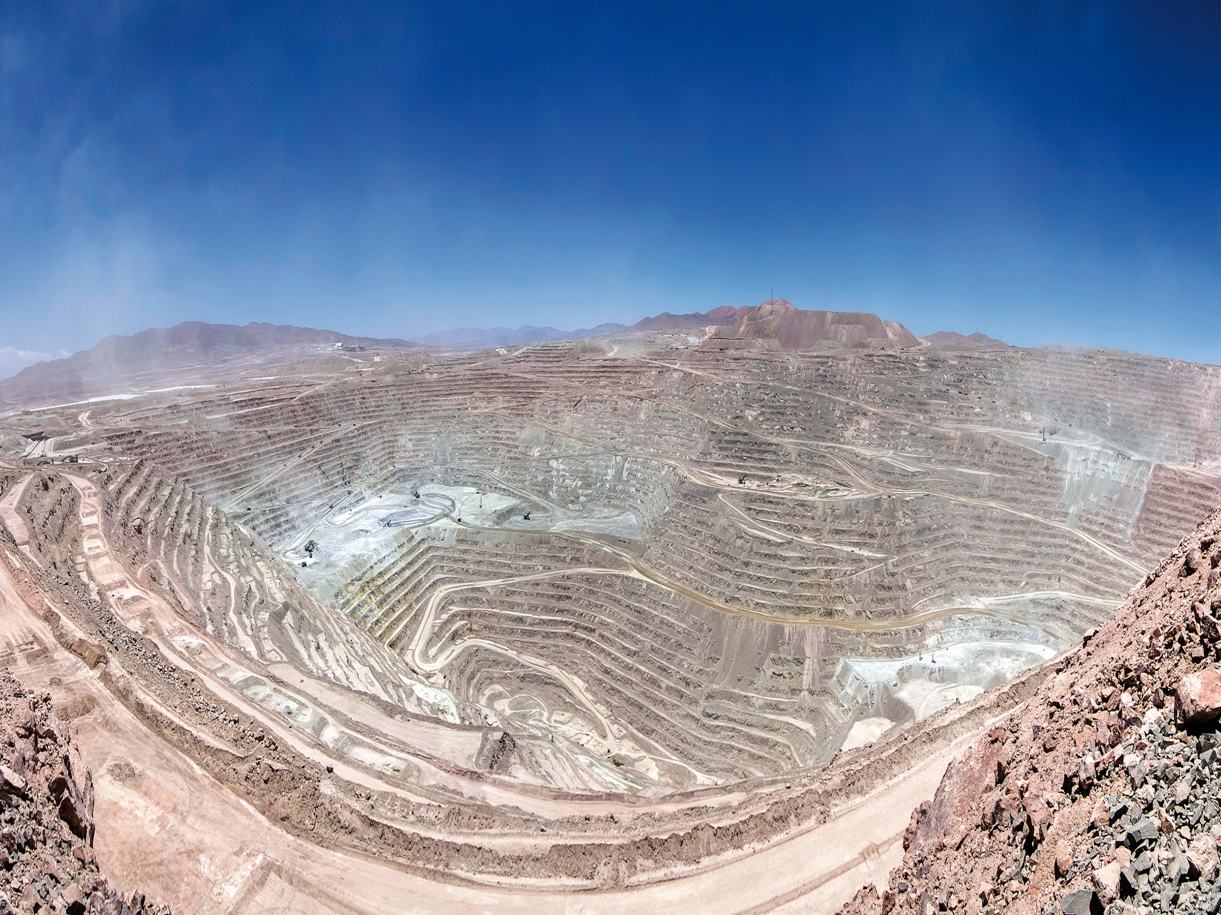
YAT Code of Conduct
What is the YAT Code of Conduct?
The Code of Conduct incorporates a professional and ethical framework to ensure that all team members are aware of the required standards of behaviour at YAT Engineering and Construction with respect to complete related actions and activities
Why have the Code of Conduct?
The Code sets the standards and guidelines in relation to behaviour at YAT Engineering and Construction
What are the benefits of the Code of Conduct?
- Creating an agreed way of behaving and operating for the entire Company
- Company culture – team members know what is expected of them in terms of behaviour
- Good communication with team members having a framework to look up when faced with a difficult situation
As a new team member at YAT Engineering and Construction you are expected to read and understand the Code of Conduct. Please see your Supervisor if you are yet to receive a copy of the Code of Conduct or need any clarity on certain aspects of the document.

Slide 6

YAT Engineering and Construction Scope of Work

Slide 7

YAT OH&S, Environment and Quality
Obligations
YAT Engineering and Construction recognises its moral and legal responsibility to provide a safe and health work environment for Employees, Clients and Visitors. This commitment extends to ensuring that YAT operations do not place the local community at risk of injury, illness or property damage. YAT consider safety to be more than a compliance issue, it’s about developing a culture of safety.
Objectives
YAT Engineering and Construction will:
Provide safe plant and systems of work
Provide written procedures and instructions to ensure safe systems of work
Ensure compliance with legislative requirements and current industry standards
Provide information, instruction, training and supervision to Employees, Contractors and Customers to ensure their safety
Provide support and assistance to Employees
YAT plans and monitors its operations to ensure that all goods and services provided will, as a minimum, conform to Client requirements
YAT back this assurance with the implementation of appropriate quality management systems which include the necessary inspections and tests and documentation that will provide evidence of compliance
The Company’s quality system is based largely on pre-commencement planning and preparation and, when required, the preparation of a project quality plan
The Management of YAT is committed to the Company goal of Client satisfaction on each and every project it undertakes

Slide 8
Discuss about MAN.02-Policies Manual
Discuss about IMS System
Discuss about Risk Assessment and SOPs
Discuss about Emergency response plan

Slide 9
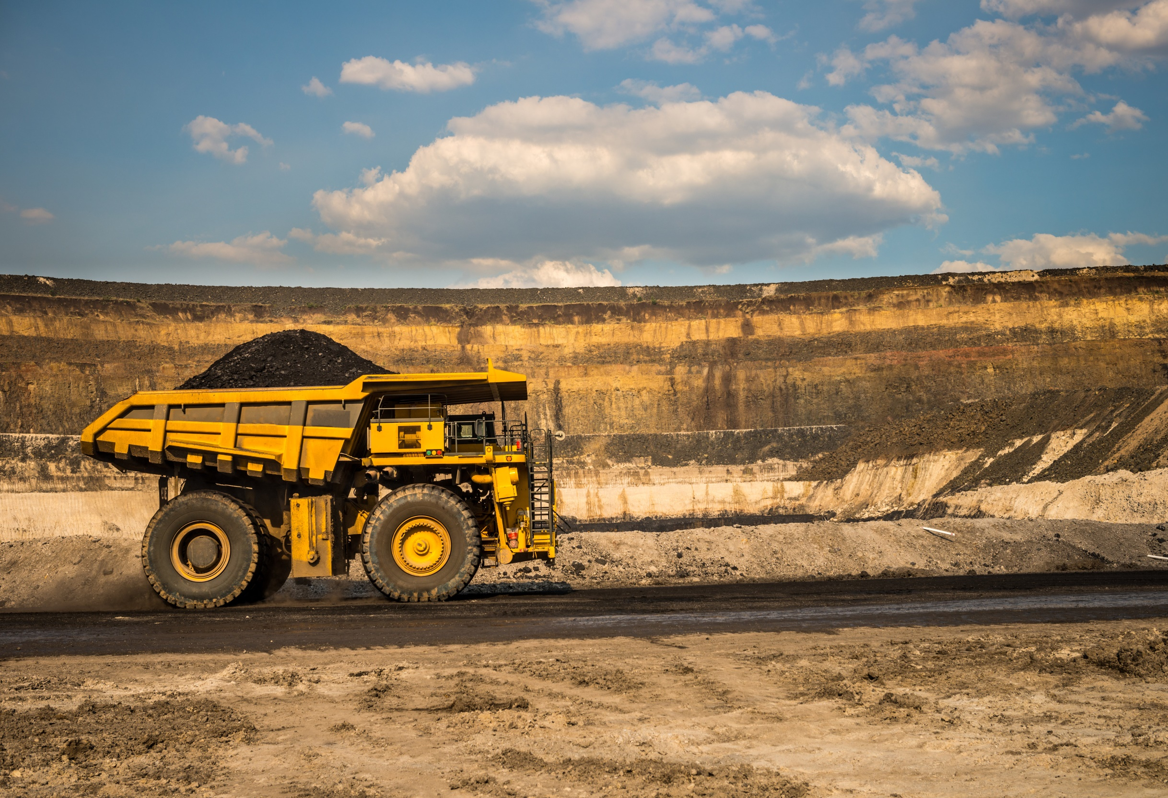
Duty of Care
YAT Engineering and Construction must provide:
A Safe work place, plant and system of work
Adequate information, instruction, training and supervision
Employees with adequate personal protective equipment
Consultation and cooperation
YAT Engineering and Construction Employees (Project Personnel) must:
Maintain their own health and safety at all times
Avoid affecting the health and safety of other colleagues
Correctly use any personal protective equipment and clothing provided
Not misuse or deliberately damage any safety equipment
Report all hazards
Report any injuries or harm to your own health and others
Cooperate with YAT Engineering and Construction

Slide 10

Hours for the Site
6.00am – 6.00pm
On site fit for work
10.30am – 11.00am
Smoko
2.00pm – 2.30pm
Lunch
Site Identification cards are to be kept on you at all times
Do not leave them in any vehicles as that vehicle may not be here when you require your card
No one is allowed to leave the site during working hours without notifying your Site Supervisor and signing the On/Off Register

Slide 11
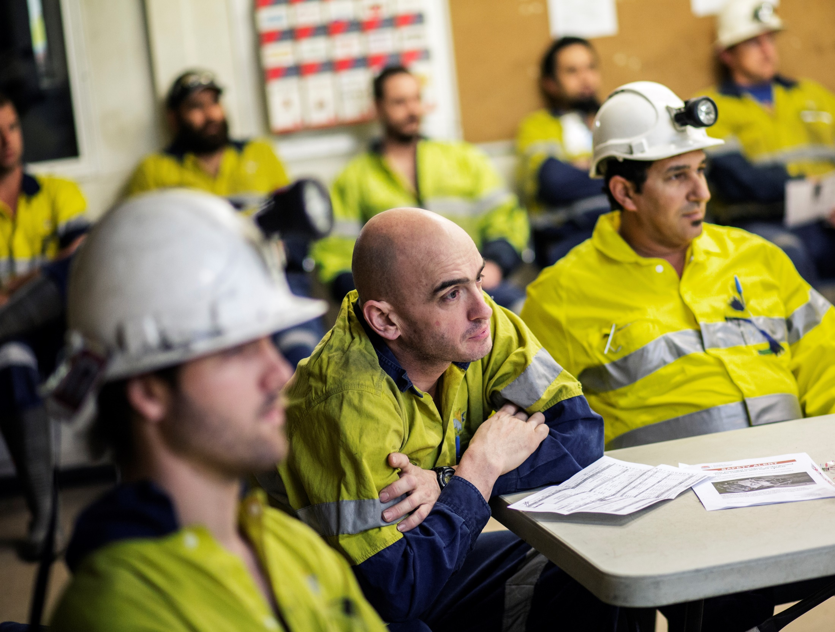
Site Specific Safety
Communication Systems
A Pre-start Meeting is held at the YAT Yard each morning at 6.00am
A YAT Debrief Meeting is held each afternoon at the YAT Office for the Project Team
Toolbox Meetings are held every second week for the Project Team
Good To Go’s are required to be completed after each Pre-start Meeting, Smoko and Lunch break.
A minimum of 3 times per day
Site Specific Systems
Hazard Reporting
Good To Go
Safe Work Procedure
Risk Assessments and Job Hazard Analysis (JHA)

Slide 12

Emergency Evacuation
Evacuation Announced
(Siren or other means)
Stop work, make safe work area, shut down all plant and equipment
All Personnel make way to the Muster Point
YAT Emergency Wardens on duty are responsible to ensure all personnel are evacuated to the Muster Point
Site Supervisors to account for all Personnel
All Personnel are to stay at the Muster Point
Await further instruction from YAT Emergency Warden
YAT Emergency Warden or delegate to respond and then contact Emergency Services
If the YAT Emergency Warden or emergency contact does not respond then the caller is to contact the Emergency Services direct
Remain Calm
State your name and location
State the nature of the emergency eg. Fire, injury etc
How many people are involved and what injuries (if known)
Hazards that maybe encountered
Stand by for further instruction (do not end phone or radio contact)
Give assistance if required and able to do so

Slide 13
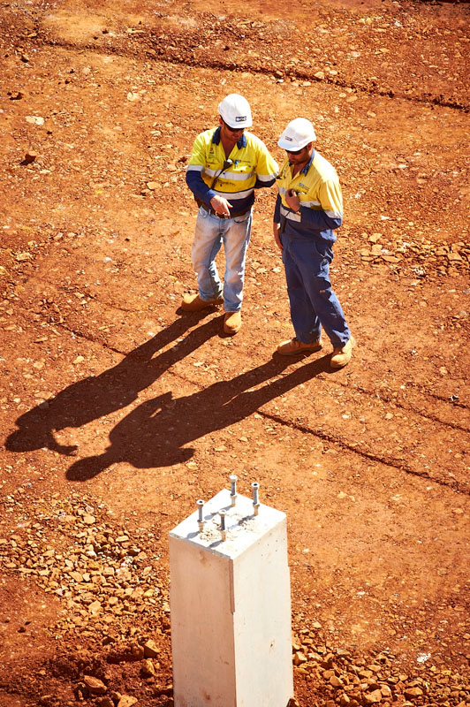
House Keeping
House Keeping is very important so please remember the following:
Keep access to work areas clear at all times
Clear away rubbish regularly and don’t allow it to build up
Store tools and equipment properly
Put unused materials back in designated areas
Keep your work area clean at all times
Clean up spills immediately

Slide 14
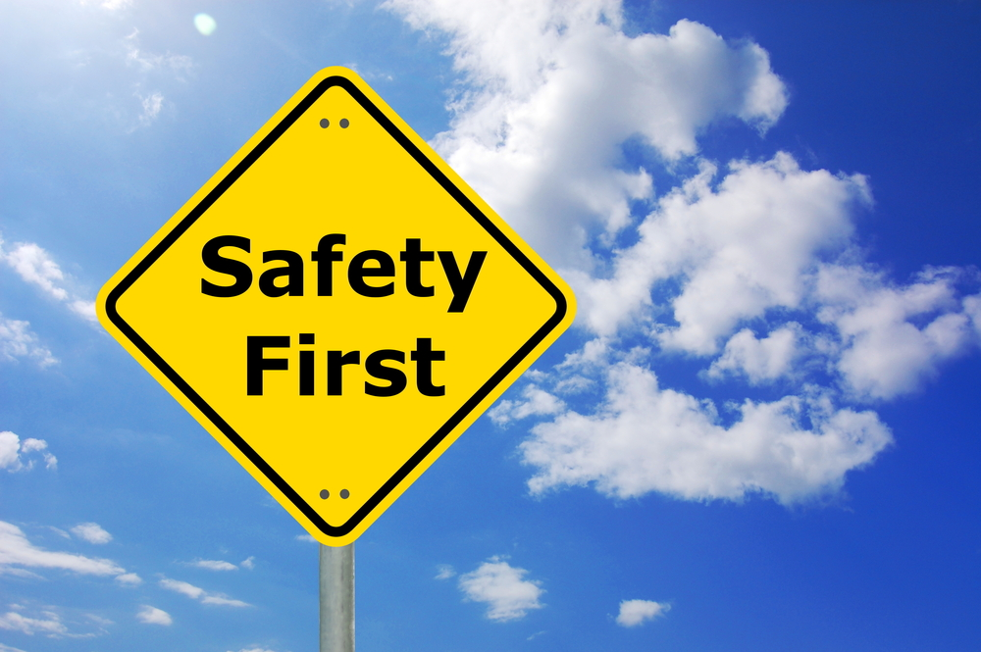
Health and Safety Resolution Process
If there is a disagreement between you and your Site Supervisor over an unsafe situation or method of dealing with an unsafe situation, the work will cease until the matter has been resolved
If it cannot be resolved between the Site Supervisor and Employee/s, the matter is to be immediately referred to the Superintendent and the relevant Safety and
Health Representative
If still not resolved, the Safety and Health Committee will meet to discuss the matter
The Safety and Health Committee will agree on whether an unsafe situation exists and, if so, determine how to resolve the issue
Where there is no agreement by the Committee an Inspector can be called to the site to assist in resolving the issue

Slide 15
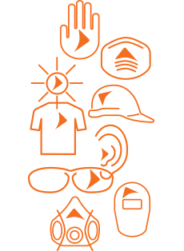
Personal Protective Equipment (PPE)
While on site YAT will provide you with the appropriate PPE to meet
the minimum requirements.
Some areas may require additional PPE such as respiratory and hearing protection.
These areas will be signposted. Gloves must be carried at all times and used for manual tasks.
Minimum PPE includes:
Safety Helmet
Approved Safety Glasses
High Visibility Long Sleeved Shirt with sleeves rolled down
Safety Gloves
Long Trousers
Steel Capped Boots
PPE is your last line of defence
PPE must be fit for use and fit for purpose
PPE must be in good condition and maintained
PPE must not be modified or altered
PPE must be worn where required
PPE must be used correctly

Slide 16
Mandatory Signs
Blue & White
Whenever these signs are encountered you must wear the appropriate Personal Protective Equipment
Warning Signs
Black & Yellow
Whenever these signs are encountered you must be careful. These signs are placed for your protection.

Slide 17
Prohibitory Signs
Red, Black & White
These signs warn you of an immediate danger to yourself and others in the area.

Slide 18
Emergency Information Signs
Green & White
These signs are used to guide you in the event of an emergency

Slide 19

Vehicles and Driving
If you have been authorised to drive an approved site vehicle, it is your responsibility to ensure that you complete the following at ALL times:
You must be VOC’d before you can drive
You must complete a Vehicle Prestart at the start of each shift and put the copy in your Supervisors tray or hand it to your Supervisor at the Prestart. If any issues are noted for repair they can be organised ASAP.
You follow all road rules and obey all road signs
You do not exceed the speed limits sign posted on site
You drive to the road conditions
You wear a seat belt
As a Driver it is your responsibility to ensure that all passengers are wearing their seat belts before you move off
Ensure the vehicle is fitted with an operational radio with Channel 12 and flashing beacons are turned on
You never drive while using a mobile phone
You never drive under the influence of alcohol or illicit drugs
Windows are kept up at all times whilst driving on site and the Air Conditioner is on re-circulate
You must stop at all stop signs and red lights, it is up to the Driver to be aware of the road conditions, failure to obey the road rules on site will result in disciplinary action

Slide 20
Haul Road LV/HV Interaction
Before you can drive on or across any haul road that is not controlled by boom gates and a set of lights you must first be authorised to do so by the Registered Mine Manager.
You must have a valid reason to do so
You must have completed the online haul road interaction training in LMS
You must have a 2-way radio that can transmit and receive on Mine Op’s 1
You must call on Mine Op’s 1 and advise your intent to cross and location
You must not cross until the haul road is clear of traffic, all haul road traffic has the right of way

Slide 21
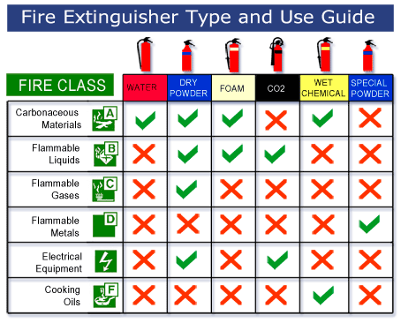
Fire Prevention and Protection
Fire Extinguishers are for Emergency Response only and must not be used for any other purpose!

Slide 22
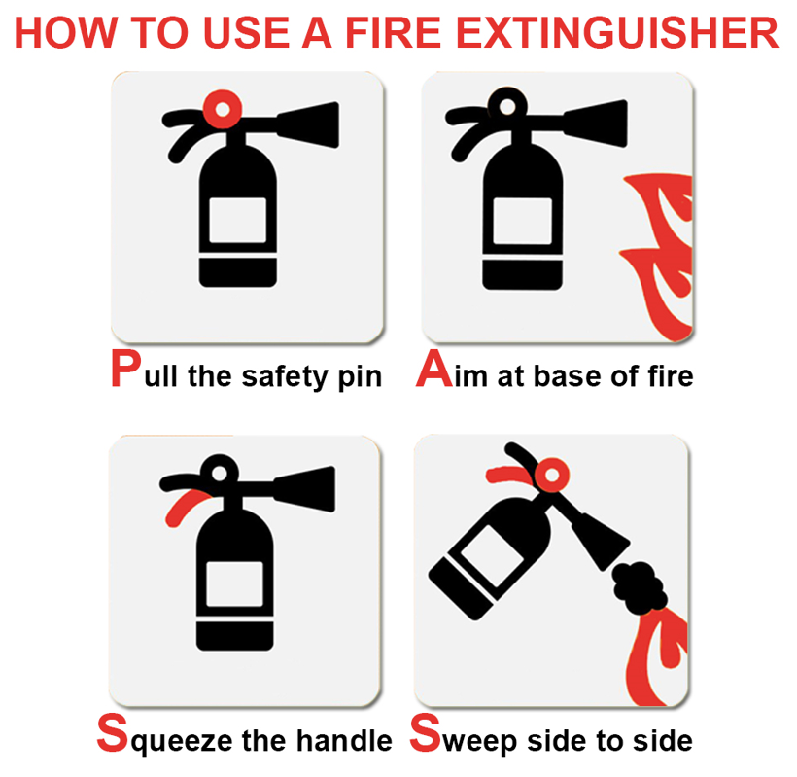
Fire Extinguisher Inspection

Slide 23
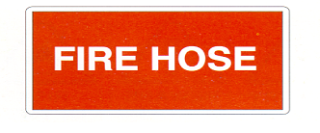
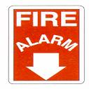

Fire Extinguisher Inspection
Accessibility – Is the fire Extinguisher in a conspicuous and accessible area?
Anti Tamper – Is the anti tamper seal intact?
Exterior – Is the exterior clean and the instructions legible?
Maintenance Record Tag – Is the tag firmly fixed to the extinguisher?
External Damage – Is there visible damage to the cylinder?
External Corrosion – Check the exterior of the extinguisher is not pitted or damaged by corrosion.
Outlet Hose Assembly – Confirm the house is securely fitted, free from obstruction, cracking or damage.
Pressure Indicator – Is the indicator legible and within operable range?
Actuation Device – Determine Actuation device is free from corrosion, moves freely and undamaged (do not discharge)
Powder – Invert extinguish and ensure powder remains free flowing, if the powder is compacted in the bottom of the extinguisher it may not flow when inverted – to loosen, turn the extinguisher upside down a few times.
Failure of any of these tests will render the extinguisher out of service

Slide 24

Managing Heat Stress
Keep hydrated by monitoring yourself and adapt to working in the heat and humidity by:
Drinking plenty of water before, after work and during the day; Small drinks more often is better than big drinks less often
Have shade breaks
Alternate your work if possible so you are not constantly in the sun
Increase air flow
Drink water frequently
If you are feeling a head ache, heavy limbs, dizzy, nausea, irritable, move to the shade and drink more water. Advise your work colleagues and Supervisor if you do not feel better
Look after your colleagues and make sure they are drinking enough water

Slide 25
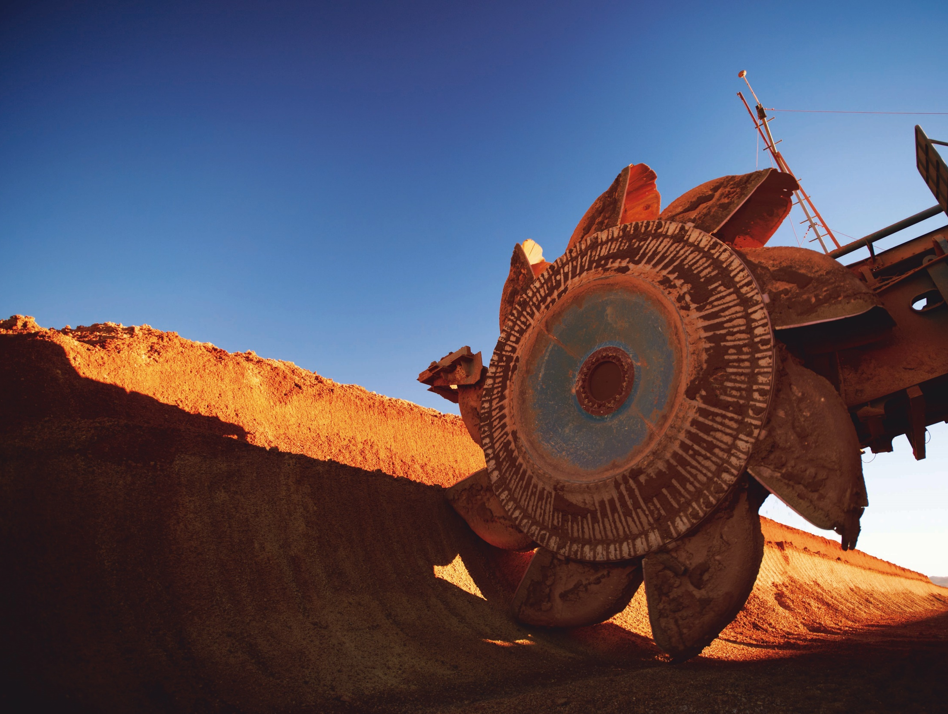
Hazard Identification
What is a Hazard?
Anything that has the potential to cause harm or damage to:
People
The Environment
Plant or Equipment
What is Hazard Identification?
This is the process of identifying all situations or events that could eventuate in hard or damage to the person, environmental or property.
It generally involves consideration of the type of injury or illness possible and the situations and events that could create potential for the injury or illness.
Hazard Identification Methods
A wide range of methods can be used for identifying hazards in the workplace and these can include:
- Injury and illness records
Review workers compensation data and sick leave records
- Workplace Inspections
Walk through surveys usually carried out by the Health and Safety Representative with the Supervisor
- Investigating workplace incidents and near miss reports
In some cases there may be more than one hazard contributing to an incident
- Feedback from Employees
They often can provide valuable information about hazards because they have hands on experience in the work area
- Up to date information
Such as manuals that come with equipment, information sheets on chemicals (MSDS), articles in the print media and the internet
- Liaising with simular workplaces
Safety alerts/notices from other organisations including Worksafe

Slide 26
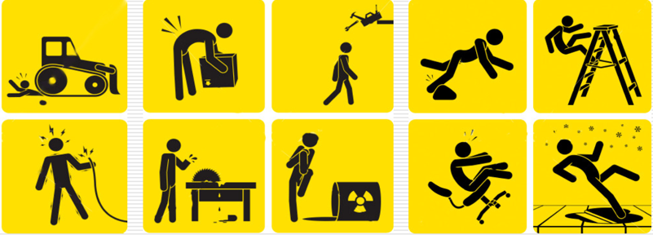
Job Hazard Analysis (JHA)
A JHA is required for ALL work
Break the job down into logical steps – involve the whole team in the planning!
The better you think about your task and put good information into your JHA the better chance you have of being aware and avoiding incidents.
- Identify hazards for each job step
- Decide appropriate controls for each of the hazards
- Use alternative methods to further reduce risks
- Gain approval from your Supervisor for the JHA to be put into use
- Controls must be implemented to be affective
- All team members to read and understand the JHA
- All team members to sign onto the JHA
- The JHA can be updated as necessary
This guy needs a JHA!

Slide 27

Barricades and Cordons
Work areas in an operational plant can be hazardous working environments.
Great care must be taken to ensure people are kept away, giving caution or physical separation from the hazards in these areas.
Separation is achieved by either Barricading or Cordoning off the area.
Site minimum is the use of tape, however for all hazardous barricades, Eg. Drop Zones, Hot Works above or men working above hard barricades is the YAT minimum.
All barricades must have current information tags and signage to warn others of what the hazard is.

Slide 28

All YAT incidents are investigated and must be documented using the CITIC Pacific Mining Accident and Incident Report Form.
There is also CITIC Pacific Mining reporting procedures that must be complied with.
Incident investigation is conducted in order to prevent occurrence of similar incidents.
Incident investigations are not an opportunity to blame
All incidents including all electrical shocks must be reported immediately to your Supervisor.
In non-emergency situations if you require treatment for an injury you must be escorted to the site medic by your immediate Supervisor.

Slide 29
All incidents must be reported immediately to your Supervisor, these include but are not limited to:
Hazards
Unsafe Acts
Near Misses
Property Damage
All injuries, including First Aid injuries
Any concerns about work safety must be reported immediately
Any muscular twinges/spasms must be reported immediately
All reports are documented immediately and investigated as required

Slide 30
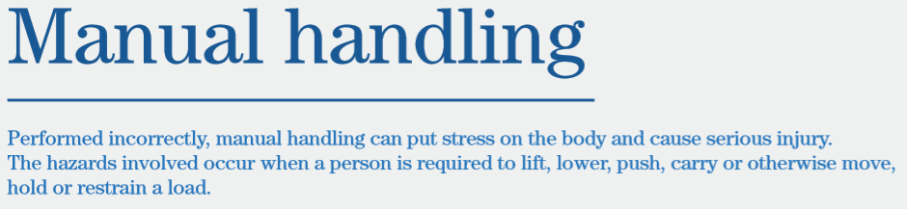
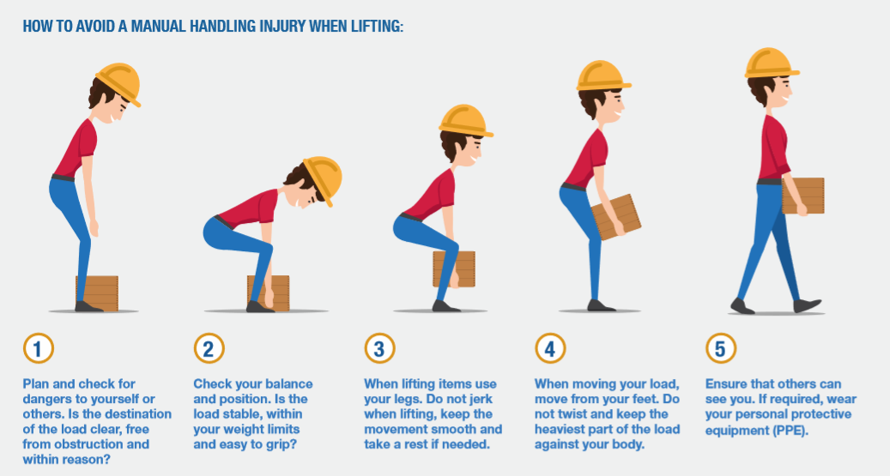
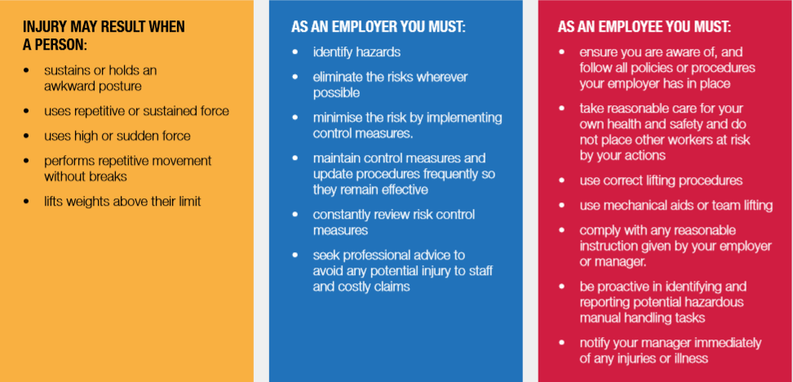

Slide 31
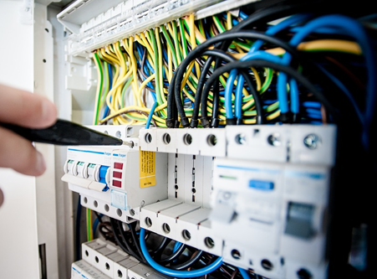
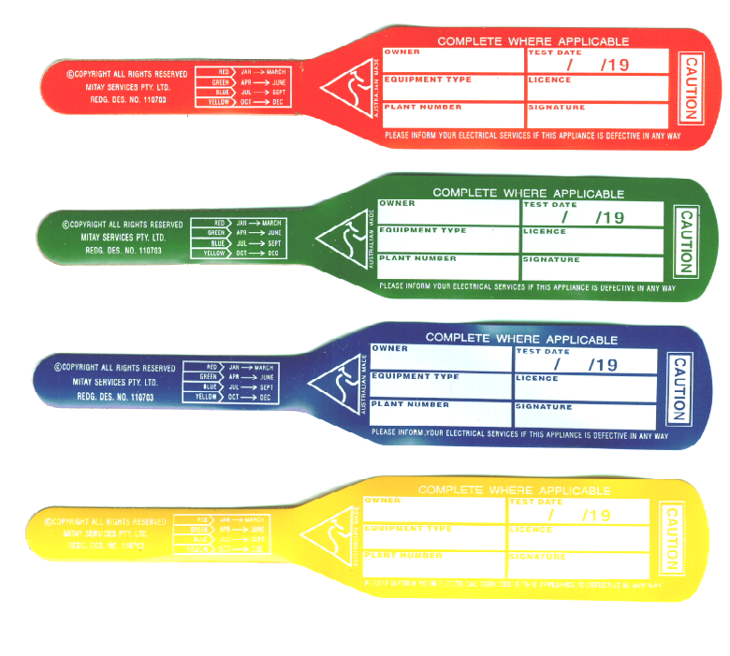
Electrical
Only authorised and qualified Electricians are permitted to carry out electrical maintenance work and repairs on site.
You are responsible for checking if your equipment has a valid inspection tag
Never use electrical equipment that has a missing or out of date tag
Always visually inspect tools and cords every time you use them
Always have electrical leads off the ground, use lead hangers or lead stands
Portable electrical equipment must be inspected and tagged on a quarterly basis.
December - February
QUARTERLY
COLOUR TAG
March - May
June - August
September - November

Slide 32
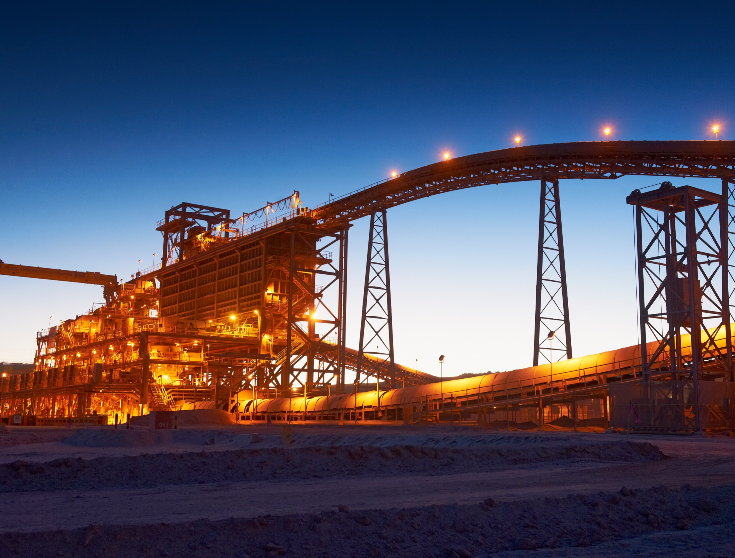
Working at Heights
Working at Heights definition:
“ Is where the person can, or has the potential to fall from one level to another and injure him or herself. This includes the potential to fall through openings, into excavations, or from one level to another.”
There is NO height minimum for working at heights at Sino Iron.
There are 2 main risks relating to all tasks involving Working at Heights: Fall from height and falling objects
Many people are killed or injured each year from working at heights, many of these incidents could have been prevented by putting some simple controls in place
As you move around site performing tasks, the job you preformed yesterday that didn’t require you to WSAH might now require you to simply because you have moved a few feet or things have changed
Before commencing any Work At Height ensure that:
- All Personnel have been trained to Work At Heights
- You have been VOC’s for Working At heights on this site
- The JHA stipulates all control measures and they have been implemented
- You have a Working At Heights checklist that has been signed by your Supervisor for the task being performed

Slide 33
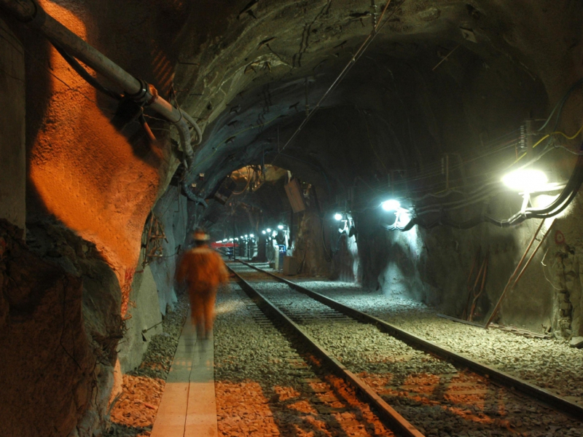
Working in Confined Space
Confined Space definition:
“An enclosed or partially enclosed space that is at atmospheric pressure during occupancy and is not intended or designed as a normal place of work.”
Before working or entering into a Confined Space, please ensure that:
- All Personnel have been Confined Space trained
- A JHA for the Confined Space has been completed and authorised
- A Rescue Plan has been prepared for the Confined Space
- You have a trained Confined Space Entry
- The Confined Space has been gas tested before each entry
- The Confined Space Entry has an Entry Log Sign-On Sheet
- External ventilation is in place (required for cutting, welding, grinding, spray painting, sand blasting etc)
- The Confined Space Entry point is barricaded and signed when the confined space Sentry is not present
- A Confined Space Checklist is available to assess work areas which are Confined Spaces

Slide 34

Hand Safety
Our hands are one of the most important tools we have and we use them for everything!
Imagine how you would cope if you lost one or both of your hands?
We use our hands to help us explore the world around us by touching and feeling everything. We use our hands often without thinking and this is when we can get hurt.
ALWAYS protect your hands by wearing the correct gloves for the task and remember to ALWAYS wear your gloves!
Never put your hands where they can be trapped or crushed.
Stay focused and think before acting!

Slide 35
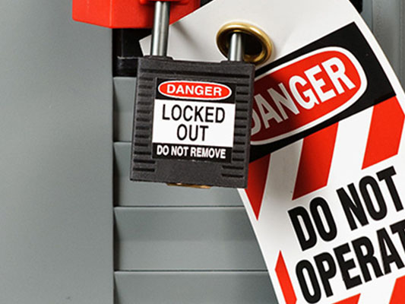
Hazardous Energy Control
When people interact with a source of hazardous energy the end result is often disastrous.
Hazardous energy is controlled by a well formulated process of isolation, locking and tagging.
This process is often referred to as LOTO – Lockout Tagout
Hazardous Energy Source Examples
Live electrical lines
Electrical capacitors
Lasers
Engines
Moving parts
Hydraulic lifts
Pneumatic (air pressure) lines
Springs
What type of Injuries can occur?
Electrocution from live electrical or moving mechanical parts
Scalding from steam or hot liquids
Chemical burns or exposure to chemicals
Machinery deep cuts and lacerations
Machinery crush injuries
Machinery amputation
When is LOTO required?
When servicing or repairing machinery or equipment that has the potential to be energized or started
Where there is the potential for an unexpected machinery start up or release of stored energy that could cause injury or damage

Slide 36
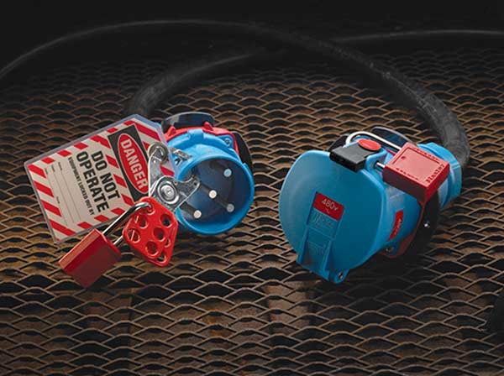
Electrical Lockout Devices
Warning!
Push buttons, selector switches and other similar devices are NOT considered Lockout Devices and must NOT being used as a substitute for the lockout devices.
Out of Service Tags
Out of Service Tags are used to identify and to place faulty or defective equipment or machinery out of service in order to prevent possible injury or damage to plant or equipment.
Anyone can attach an Out of Service Tag to faulty or defective equipment.
All sections on the tag are to be completed correctly.
The person who has attached the Out of Service Tag must immediately inform his/her Supervisor why the equipment tag has been placed on the equipment.

Slide 37

Sino Iron mine site as potentially harmful mineral fibre. Citic Pacific Mining is committed to fibrous minerals management on site through the CPM Fibrous Minerals Management Plan. This section of the Induction Program is to ensure that you are aware of the risks associated with fibrous minerals and how YAT will provide you with the best tools to protect yourself whilst working on this site.
It is very important that you follow all procedures and processes for managing fibre.
Fibrous minerals is a general term for any fibre that occurs naturally
There are many types of potentially hazardous fibrous minerals or fibres that are found all over the world
Not all fibres are considered hazardous or dangerous

Slide 38
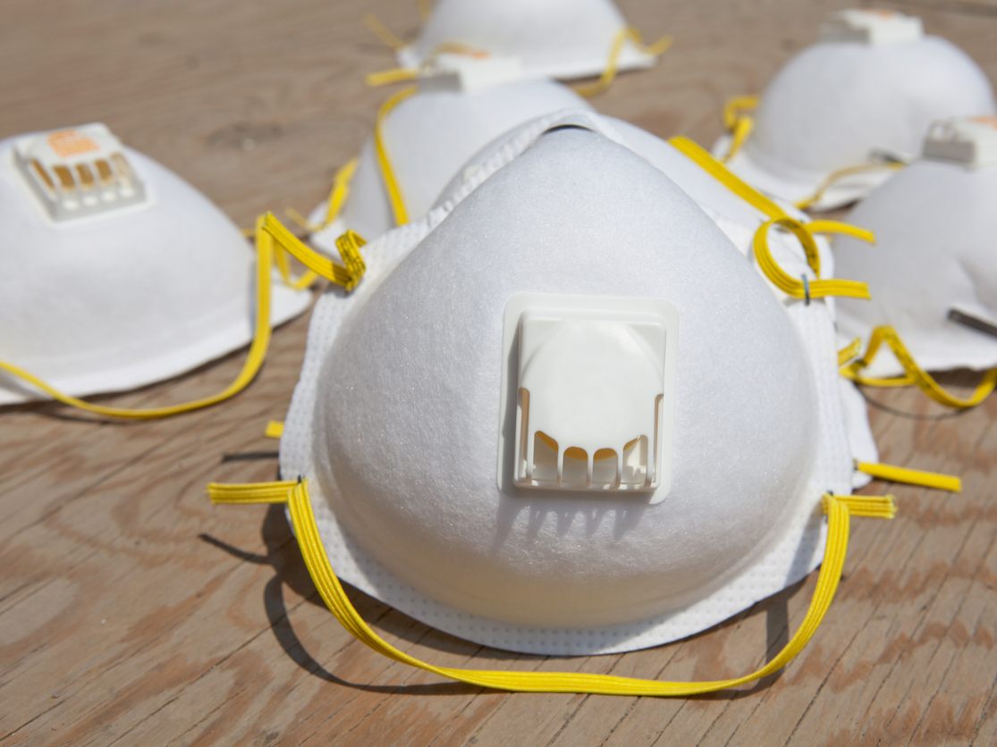

Where is fibre found on this site?
Extensive studies have identified fibrous minerals in our main source of ore on the mine site. Areas that have been confirmed or are suspected to contain fibrous minerals are marked as a designated area. A single designated area status applies across CPM operations.
When entering a designated area you must adhere to all signage and instruction. No person shall enter a designated area without: Completing a respiratory fit test and wearing their assigned mask.
What can I do to protect myself?
All personnel must follow all safety procedures onsite. These procedures include information on: Wearing PPE, safe removal of masks, use, storage and maintenance of masks, being clean shaven at all times, decontamination and dust suppression.

Slide 39
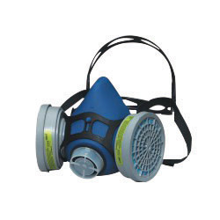
Respiratory Requirements
In accordance with Citic Pacific Mining’s Health and Safety Procedure, all Personnel who are required to wear Respiratory Protective Equipment (RPE) must comply with the following requirements:
Clean shaven requirement
Beard growth, long hair and facial features may prevent an adequate seal between the wearer’s face and the fitting surface of Respiratory Protective Equipment (RPE)
To be considered clean shaven, faces must be clear of stubble or beards where the respirator makes contact with the skin
Employees shall not be fit tested if they have facial hair that interferes with the seal between the face and the respirator
Employees who are not clean shaven shall not be allowed to wear a respirator
Employees must not enter mandatory respiratory protection zones without an approved fit tested respirator
This requirement also applied to specific tasks that require respirator use in areas outside of Designated or P2 Areas

Slide 40
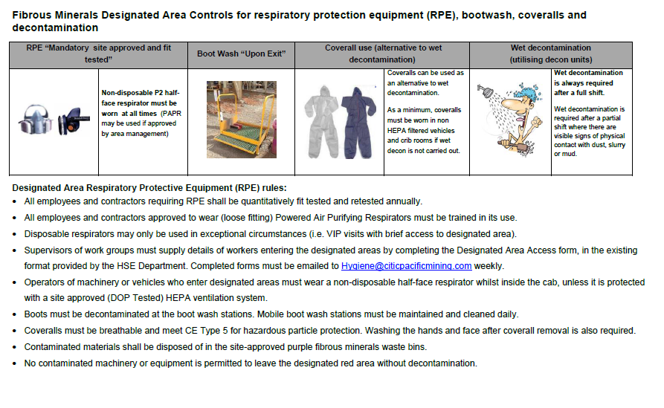

Slide 41
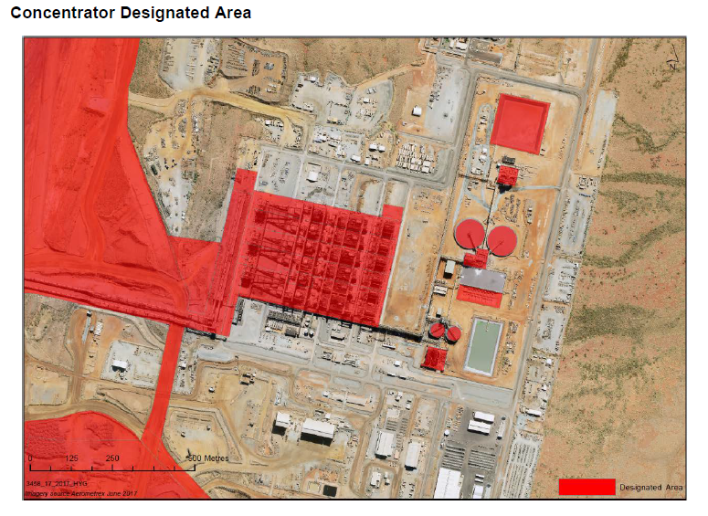
Designated Zone Maps
Concentrator Area

Slide 42
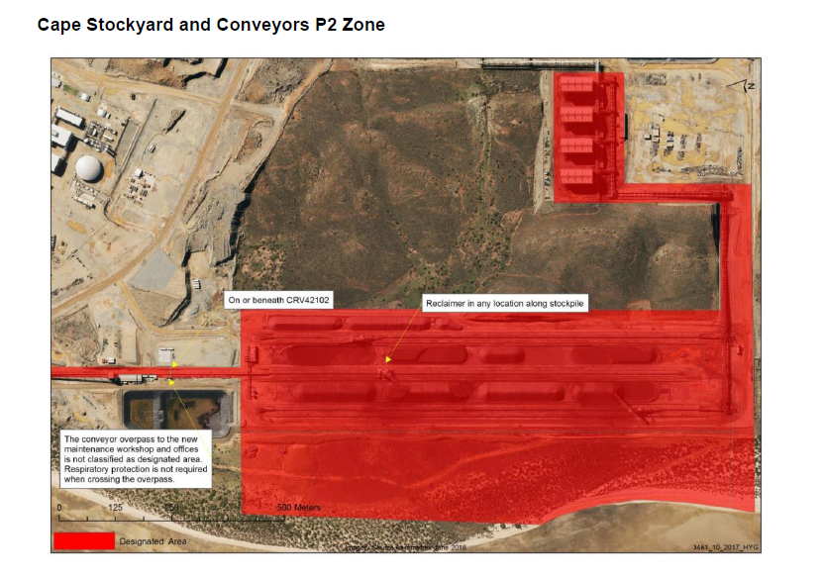
Designated Zone Maps
Stockyard and Conveyors

Slide 43
Designated Zone Maps
Tailings Storage Facility

Slide 44
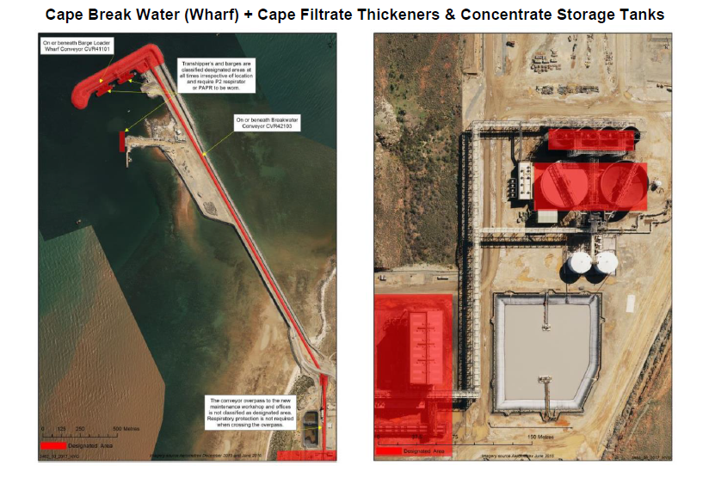
Designated Zone Maps
Cape Break Water and Filtrate Thickeners and Concentrate Storage Tanks

Slide 45
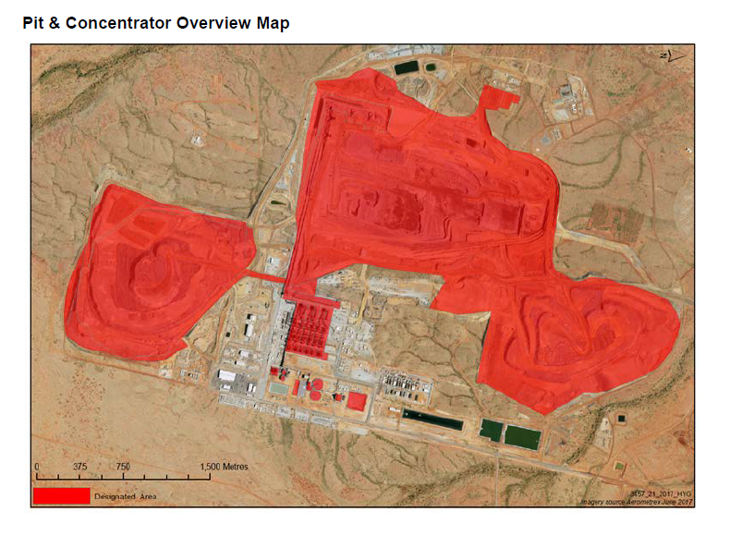
Designated Zone Maps
Pit and Concentrator Overview

Slide 46
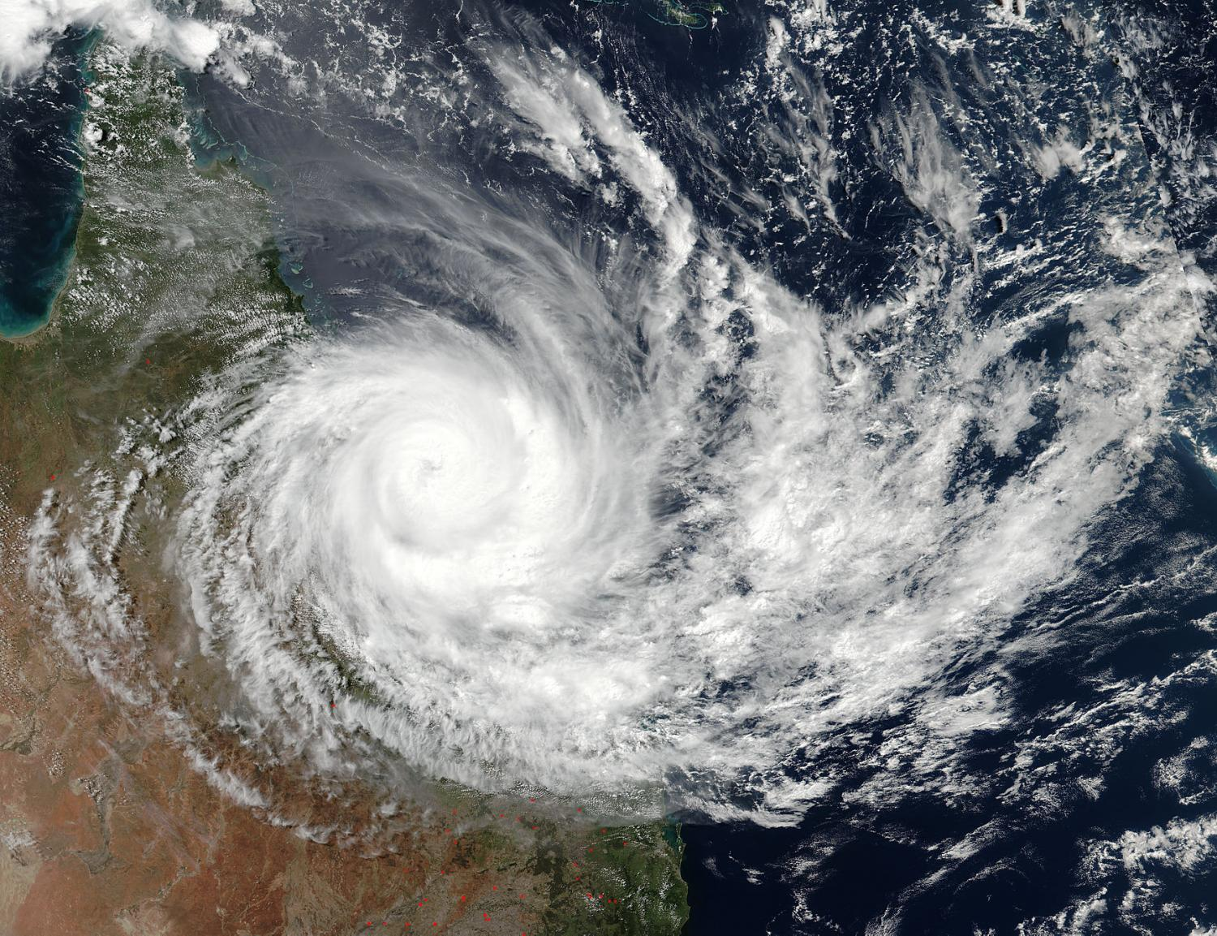
Cyclone Season Information

Slide 47

Alert Status
PREPARATION
A cyclone has formed off the coast and is less than 72 hours but greater than 48 hours away.
Confirm your status and accommodation – are you being evacuated or are you staying on site?
- People may be instructed to leave site for early R&R
- People may be delayed when returning to site from R&R
- Non-essential people will be moved off site
If you are being evacuated – confirm your flights and ensure you arrive at your destination. Ensure that your Supervisor knows of your location at all times and you are aware of your requirements.
Villages will supply sufficient food, water supplies and ration packs to those who are staying on site.
All plant and equipment not intended to be used over the next 48 hours will be secured.

Slide 48

Alert Status
TIE-DOWN
Cyclone is less than 48 hours away from the project.
People will have been informed if they are remaining on site or being relocated off site.
All operational and construction activities will cease.
Personnel who are remaining on site are to assist with tying down all work areas, even areas that you do not work in. Hard hats with chin straps, safety glasses, safety boots and gloves must be worn at all times during this stage due to the increasing winds. JHA’s will be drafted and will need to be adhered to in regards to the tie down process.
Once tie down has been completed all essential Personnel will return to the respective accommodation. Updates on the cyclones status will be televised over the camps TV Service. Personnel are required to stay alert and be prepared. This includes Employees with accommodation within Karratha.
Alcohol sales in the wet mess will cease.

Slide 49

Alert Status
SHELTER
Cyclone is less than 12 hours away from the project.
A siren will signal when the SINO Cyclone Status has changed to SHELTER.
By this stage the site is secured and locked down.
All Personnel will either have been relocated off site or been sent to an Accommodation Village.
Personnel on site will be instructed to remain in their own accommodation or refuge centre until the all clear signal has sounded or you have directed to do so.

Slide 50

How will people on site be managed during a Cyclone event?
For all SHELTER alert cyclone events people may either be evacuated or remain on site. You will be notified if you are being evacuated or remaining on site.
People must remain in their accommodation or refuge centre until instructed it is safe to leave
All IL4 cyclone rated rooms are identified with a GREEN sticker on the outside of the room
All IL4 rated village accommodation units and refuge centres comply with the Australian Standards for cyclone shelter.

Slide 51

Alert Status
ALL CLEAR
The threat has passed, inspections are conducted prior to returning to work.
The Cyclone Committee will announce the all CLEAR with caution status when the cyclone has passed and winds have abated to a point where it is safe to conduct surveys.
Sirens will sound at each village to advise when the status is all CLEAR.
All Personnel are required to proceed with caution and are not permitted to return to work or site until they are instructed to, by their Supervisor.
Everyone must remain Fit for Work during cyclone events on site.

Slide 52

Any Questions?

